Slide 1
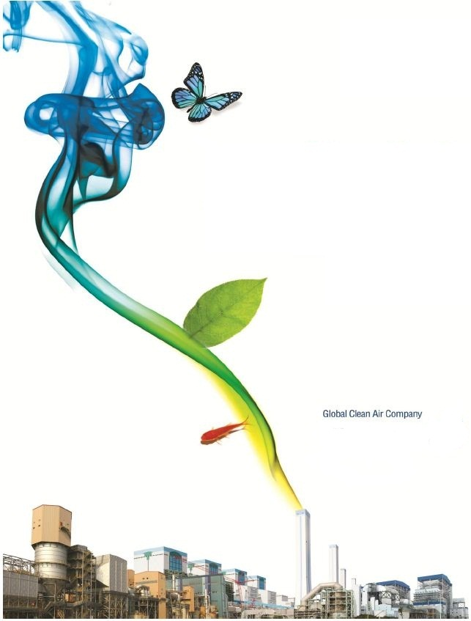

KC COTTRELL VIETNAM
COMPANY PROFILE
The Leading Environment Protection Company
as a first specialist in Vietnam
KC COTTRELL VIỆT NAM
BROCHURE
2020

Slide 2

Contents
1. Company Introduction
General Introduction
Certificates
Organization chart
Mission and Vision
2. Products and services
Air Pollution Control equipments
Dampers
Industrial equipments
Spare parts
Services
3. Experiences
Experience of Air Pollution Control (APC) supply
Experience of spare parts and technical service supply
Experience of Collecting Plate (CE) Manufacture
Experience of KC Cottrell (Holdings company)
4. Networks
5. Social activities

Slide 3
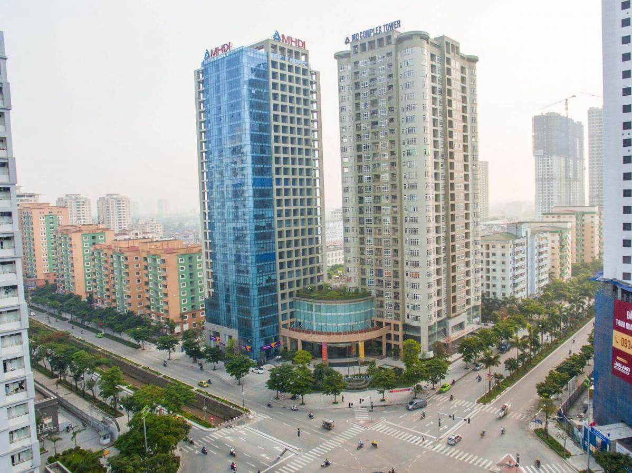
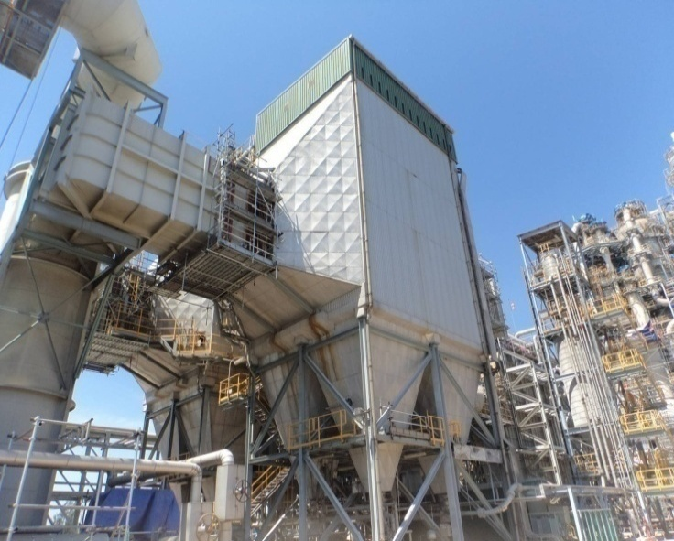
1. COMPANY INTRODUCTION
KC Cottrell Việt Nam là công ty đứng đầu Việt Nam về xử lý ô nhiễm môi trường, được thành lập năm 2008 tại Hà Nội từ 100% vốn đầu tư của tập toàn KC Green Holdings. Theo định hướng toàn cầu hóa, tập đoàn KC Green Holdings đã thành lập hơn 36 chi nhánh và công ty con tại nhiều quốc gia như Anh, Mỹ, Đài Loan, Trung Quốc, Ấn Độ… trong có Việt Nam.
KC Cottrell Việt Nam đã được chuyển giao công nghệ và kinh nghiệm của KC Cottrell (từ 1973) và Lodge Cottrell (từ 1913) và mở rộng hoạt động tại thị trường Việt Nam và khu vực Đông Nam Á.
Cho đến nay, KC Cottrell và Lodge Cottrell đã lắp đặt hơn 8.000 hệ thống xử lý ô nhiễm môi trường trên thế giới trong khi KC Cottrell Việt Nam đã cung cấp thành công gần 20 hệ thống cho thị trường Việt Nam.
Công ty chúng tôi thực hiện dự án EPC (Thiết kế – Mua hàng – Xây lắp) cho các dự án, hệ thống môi trường , cung cấp dịch vụ kỹ thuật sau bán hàng và giải pháp toàn bộ tổng thể về môi trường nhằm mang đến sự hài lòng cho khách hàng.
KC Cottrell Vietnam Co., Ltd., 100% invested by KC Green Holdings, established in 2008 in Hanoi and has become the leading specialized Pollution Control company in Vietnam. On the direction of globalization, KC Green Holdings has established over 36 subsidiaries in many countries such as United Kingdom, USA, Taipei, China, India and Vietnam…
KC Cottrell Vietnam has been transferred know-how and technology license from KC Cottrell in Korea (since 1973) and Lodge Cottrell in United Kingdom (since 1913) and covers Vietnamese and South East Asian market.
Over the years, KC Cottrell and Lodge Cottrell have installed more than 8,000 effective environmental systems in the whole world while we has successfully supplied about 20 air pollution control systems in Vietnamese market.
We executes EPC (Engineering - Procurement – Construction) Base Projects, and Provides after-market service for Pollution Control and related technical services, providing a total solution for environment related issues that fully meets customer’s satisfaction.
Head office
ESP of Dung Quat Oil Refinery

Slide 4
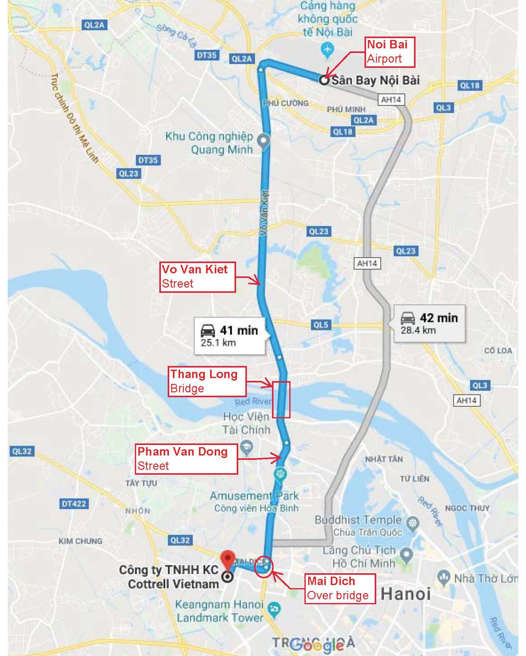
Location of KC Cottrell Vietnam on the Google Maps
KC COTTRELL VIET NAM CO., LTD.
Office : 23rd Fl., MD Complex Tower, 68 Nguyen Co Thach Street, My Dinh 1 urban area,
Cau Dien ward, Nam Tu Liem district, Hanoi, Vietnam.
Phone : +84-24-3768-9904~05 * Fax: +84-24-3768-9902
Email : info@kc-cottrell.com.vn
Website : http://kc-cottrell.com.vn

Slide 5
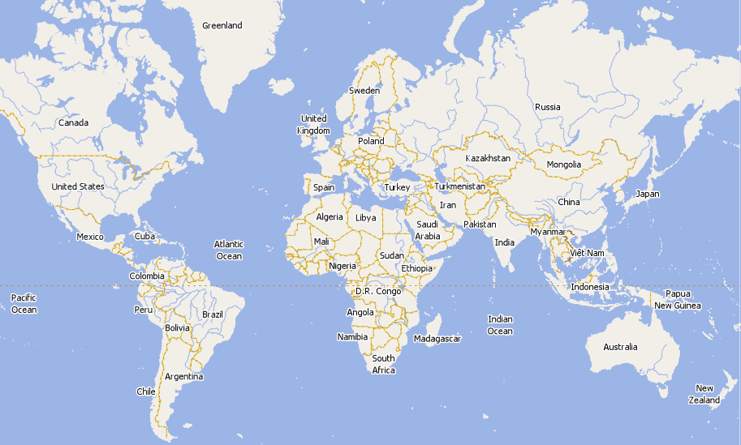
GLOBAL NETWORKS
KC Enviro Services Co., Ltd.
Lodge Cottrell Ltd.
KC Cottrell Co., Ltd.
Clestra Hauserman Ltd.
KC Cottrell China Co., Ltd.
KC Envirotech E&C (Fushun) Co., Ltd.
Korea
KC Catalyst Services Co., Ltd.
NWL Pacific Co.,Ltd
Lodge Cottrell India Pvt. Ltd.
KC Cottrell Taiwan Co., Ltd.
Lodge Cottrell Inc.
KC Cottrell Vietnam Co., Ltd.
Affiliated Companies
Environmental Engineering
KC Cottrell Co., Ltd.
KC Cottrell China Co., Ltd.
KC Cottrell Vietnam Co., Ltd.
KC Cottrell Taiwan Co., Ltd.
Lodge Cottrell Ltd. (UK)
Lodge Cottrell Inc. (USA)
Lodge Cottrell India Pvt. Ltd.
NOL-TEC System, Inc.
NOL-TEC Korea Co., Ltd.
KC Air Filter tech Co., Ltd.
Environmental Services
KC Enviro Services Co., Ltd.
KC Landfill Service Co., Ltd.
KC Hanmi Environment Co., Ltd.
KCMS Co., Ltd.
Veolia ES&KC EcoCycle Co., Ltd.
KC Jeongrim Environment Co., Ltd.
KC Catalyst Services Co., Ltd.
KC Xanh Co., Ltd.
Lilama EME JSC.
Renewable Energy
KC Solar Power Co., Ltd.
KC Energy Co., Ltd.
KC Green Energy Co., Ltd.
Korea Solar Holding Company Co., Ltd.
KC Biomass Power Co., Ltd.
Environmental Manufacturing
KC Envirotech E&C(FuShun)Co., Ltd.
NWL Pacific Co., Ltd.
Clestra Hauserman Co., Ltd.
Noltech system Co., Ltd.

Slide 6


Viet Nam Network
Leadership by everyone
KC cottrell Viet Nam co., ltd
Mutual respect
KC XANH JSC
Environtment protecttion
KC Solar co., ltd
Open comunication
Lilama EME JSC

Slide 7
Contact
CEO | Yeom Dong Gyun
Founded on | 28th Nov. 2008
Address | 23rd Fl., MD Complex tower, My Dinh 1 urban area, Cau Dien ward, Nam Tu Liem district, Hanoi, Vietnam
Tel | +84-24-3768-9904~05; Fax: +84-24-3768-9902
Website | www.kc-cottrell.com.vn
Email | info@kc-cottrell.com.vn Hotline: +84-0934 511 816
Business Content
Electrostatic Precipitators, Bag Filters
De-SOx System (FGD, GSA SYSTEMS) & De- NOx System (SCR, SNCR)
Ash Handling System ( Bottom & Fly)
Technical Service & Environmental Machinery
Environmental Machinery
Technical Consulting
Waste Incineration Plant and Landfill service
Industrial application
Power
Plant
Cement
Steel
Oil &
Chemistry
Fertilizer
Glass & Paper
Others

Slide 8
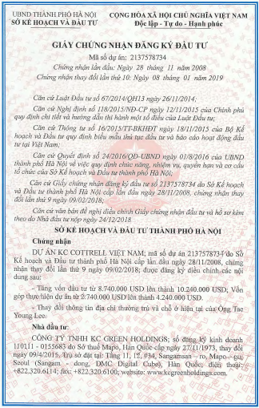
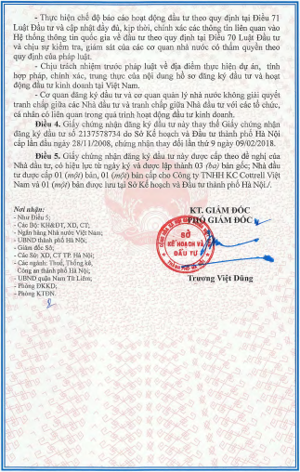
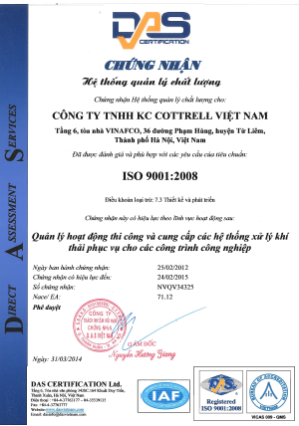
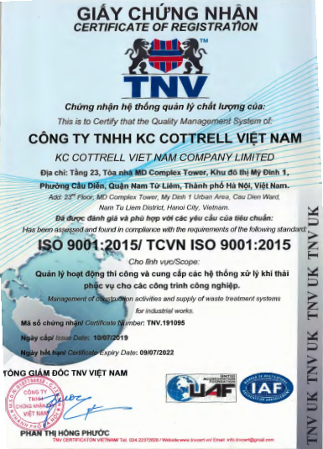
Certificate of investment
Quality Management System: ISO 9001:2015

Slide 9
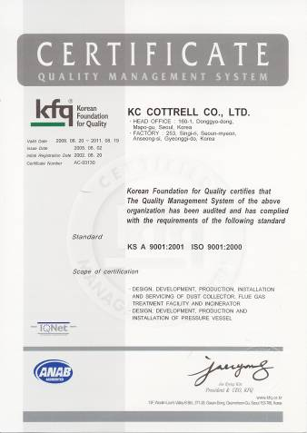
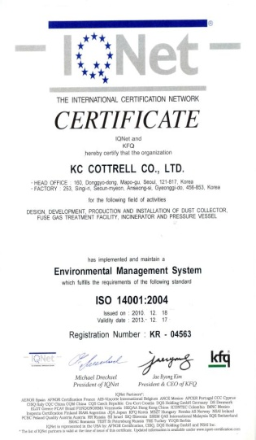
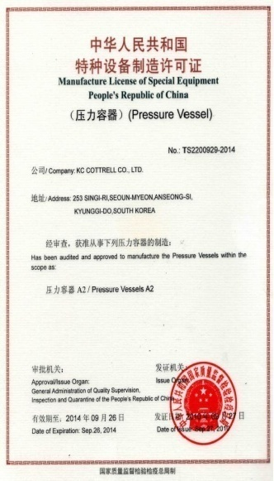
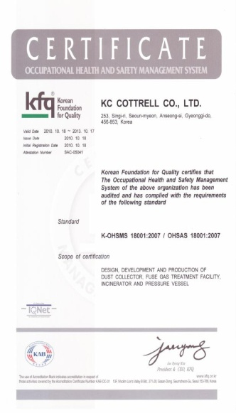
The Accredited certificates of authorization
ISO 9001
ISO 14001
ASME-U
ASME-U2
ASME-R
ASME-S
SEL
KOSHA/OHSAS 18001

Slide 10
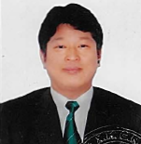
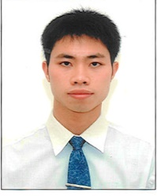
Organization chart
General
Director
Director
V. General
Director
RM Team
Project
Management
Procurement
Team
HR & Finance
ES Team
Mission and Vision
Mission
Vision
Self – stand on EPC Contractor for Air Pollution Control Business
Built up reputation
Contribute to KC Group
Become the leading Environmental Protection
Company as a first specialist in Viet Nam on the
basis of providing best Engineering, Technology
& Services and creating better reputation

Slide 11
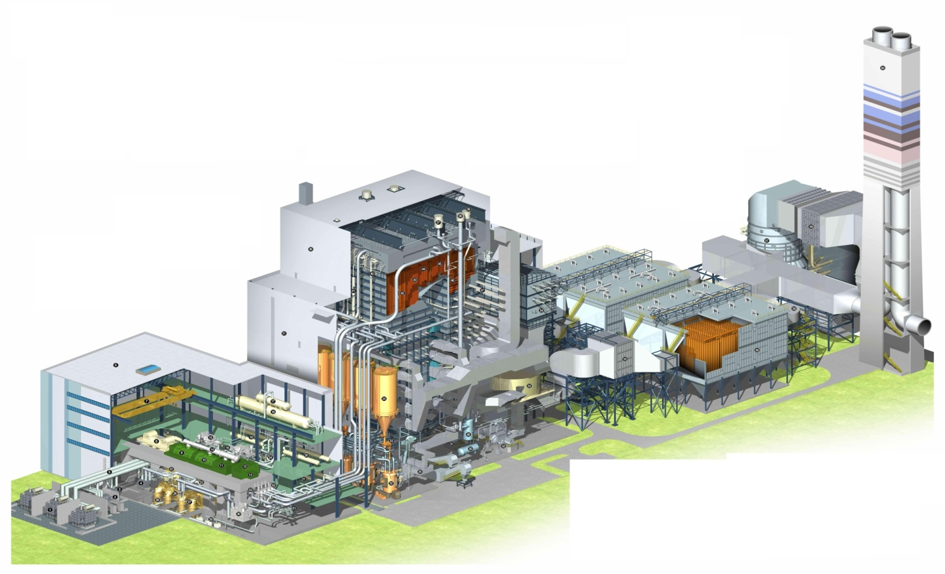
Air Pollution Control equipments
2. PRODUCTS AND SERVICES
Dust Collection Systems
Gas Treatment Systems
Ash Handling Systems
De-NOx Systems
Environmental Equip.
Boiler
FGD
SCR
FAS
ESP
Generator
Turbine
Gas Heater
BAS

Slide 12
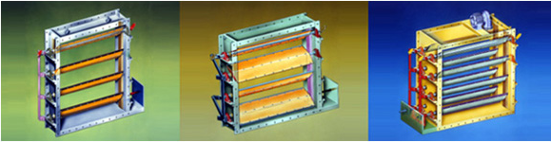
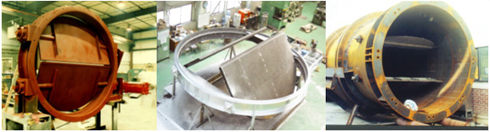
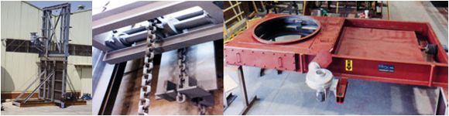
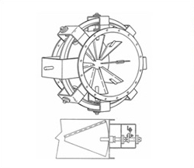
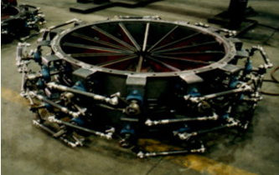
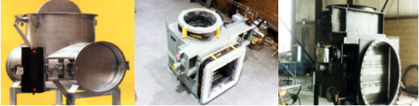
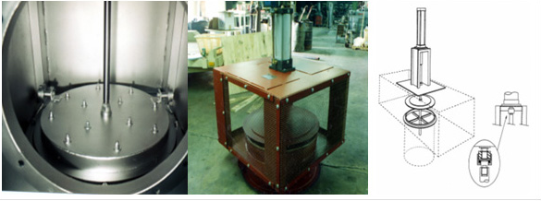
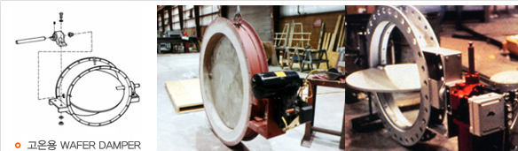
Dampers
Dampers have a wide range of applications in manufacturing lines. For example, they are used to control the amount and direction of air flow in the duct line and to block isolate toxic gases. Dampers come in a variety of forms depending on the application.
Louver Damper
Stack Isolation Damper
Guillotine Damper
Radial Vane Damper
Diverter Damper
Poppet Damper
Wafer Damper

Slide 13
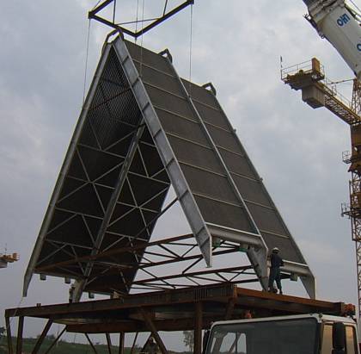
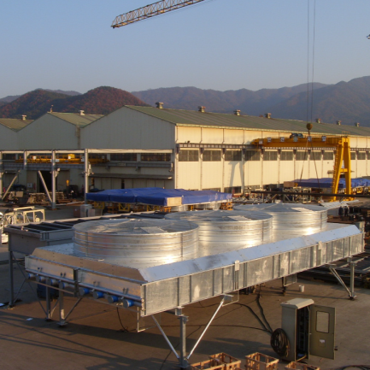
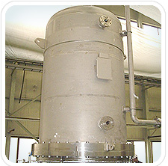
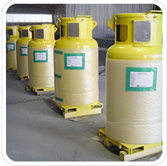
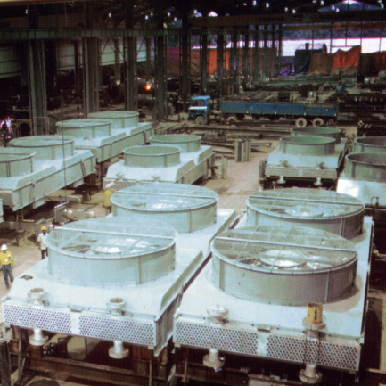
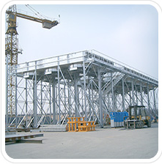
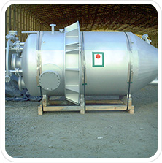
Industrial equipments
Air Cooled Heat Exchanger
Pressure Vessels
Heat exchanger is device that transfers heat between liquids. It is indispensable in petrochemical plants, oil refining plants, and power plants. KC Cottrell produces an air-cooled heat exchanger (ACHE). The ACHE is an environmentally friendly device that resolves problems associated with water-cooled heat exchanger, which include erosion, water supply needs, and ocean warming (when seawater is used for cooling). It is particularly well suited for arid regions such as the Middle East where there is a shortage of industrial use water.
Pressure vessels are designed to enable gas, liquid or a mixture to withstand pressure that is lower or higher than atmospheric pressure generated during storage, reaction or separation processes.
CVD Reactor
UN Vessel
Gas Scrubber

Slide 14
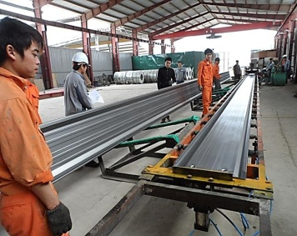
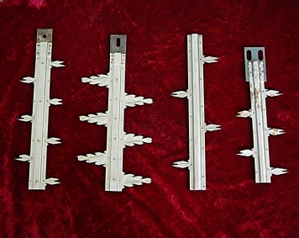
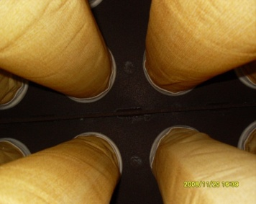
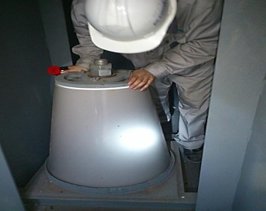
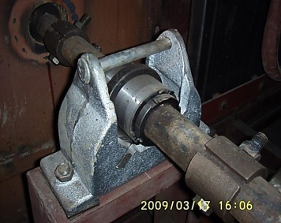
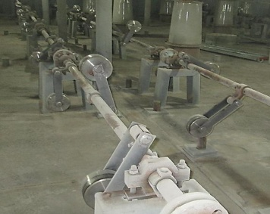
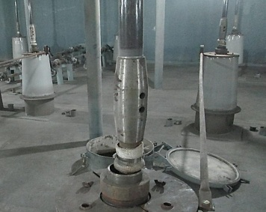
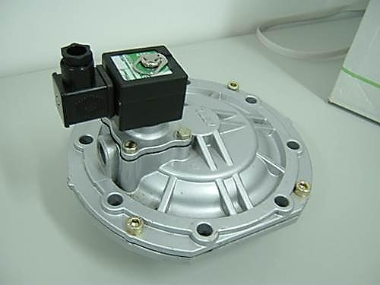
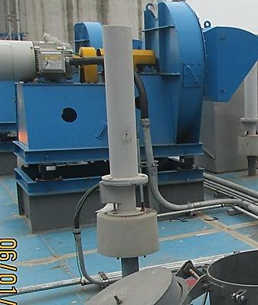
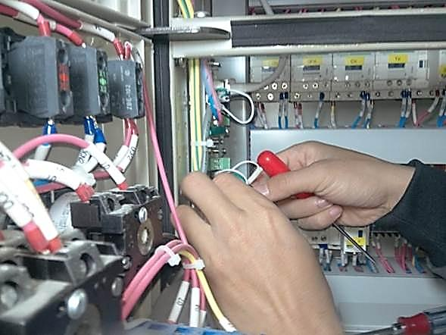
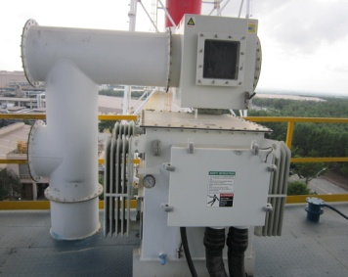
Spare parts
KC Cottrell Vietnam is working on developing technologies and environmental manufacturing products to meet the demands of customer and the market. Our product always in highest quality and can be
immediately supplied right to customer’s hand with diversified types and abundant quantity.
Collecting Electrode
Discharge Electrode
Bag Filter system
Bushing insulator
Bearing parts
Hammer/Rapper Acc’
FRP/ Porcelain shaft
Diaphragm Valve
MIGI/Magnetic rapper
PLC/ Controller system
Transformer Rectifier

Slide 15
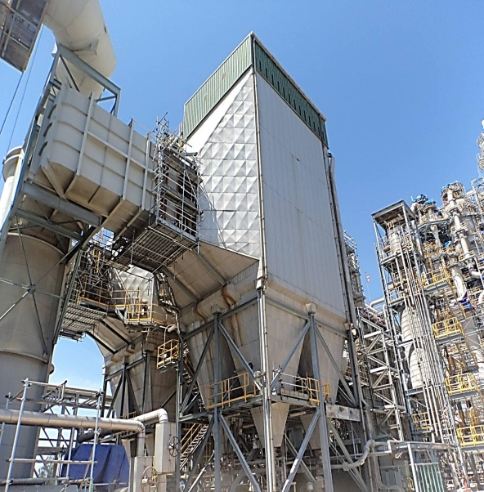
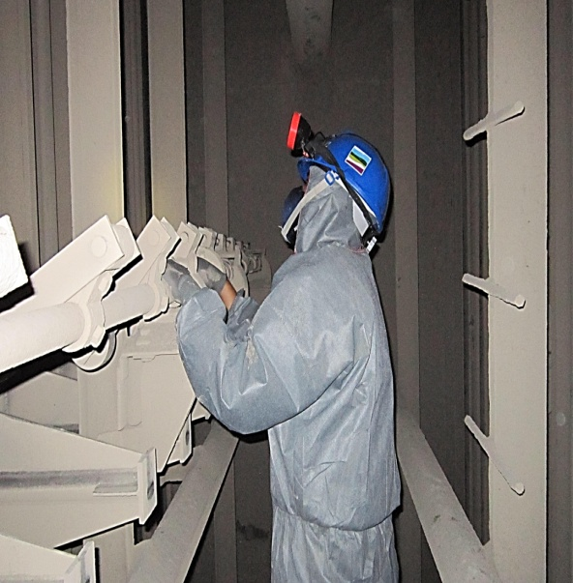
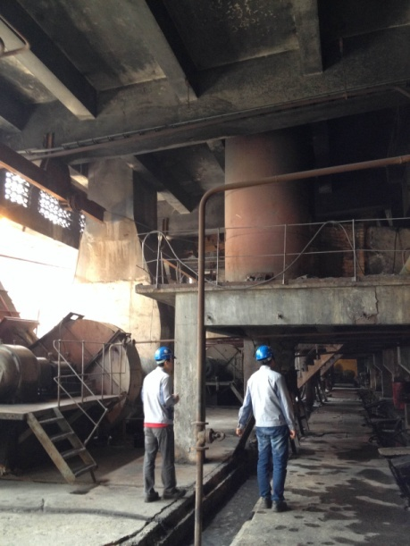
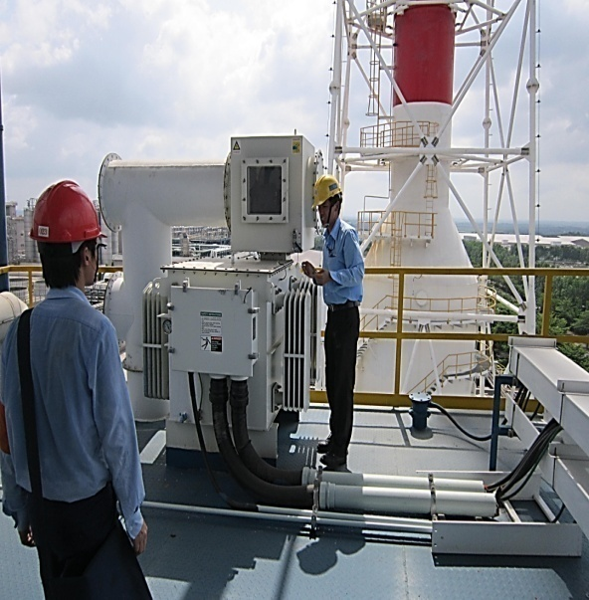
Technical Service
Based on the accumulated technologies and knowhow of KC Cottrell Vietnam,
we provide technical service such as consulting, inspection and diagnosis of
client’s environmental facilities.
1. Efficiency upgrade
and Operation inspection
2. Analysis report
and maintenance programs
3. Overhaul supervisor
and repairing work
4. Meet 100% customer’s
need and maximize clients’ competitiveness.

Slide 16
3 . EXPERIENCES
Experience of Air Pollution Control (APC) supply: 36 APC systems in VN
No. | Project | Scope of supply | Completion year
1 | Quang Ngai Sugar Corporation in Vietnam | Multi-Cyclone | 1999
2 | Dung Quat Oil Refinery in Vietnam | ESP, Ash Handling system | 2009
3 | PT. Petrokimia Gresik Cement Retarder Plant Rehabilitation in Indonesia | ESP | 2010
4 | Dong Nai VN2 Thermal Power Plant 150MW in Vietnam | ESP | 2011
5 | Taganito Thermal Power Station Formosa Heavy Industries Corp. in Philippines, | ESP | 2013
6 | Davao Thermal Power Station in Philippines | ESP | 2013
7 | POSCO Eng. & Construction Co., Ltd. Sinter Plant No. 1, Sinter Machine Process in Indonesia | ESP | 2014
8 | Nghi Son 1 Thermal Power Plant (300MW x 2) in Vietnam | 2 ESP | 2015
9 | Mong Duong 2 Thermal Power Plant (600MW x 2) in Vietnam | 2 ESP, 2 SCR | 2014
10 | Ha Tinh Steel Mill plant in Vietnam | Wet ESP | 2015
11 | Dong Nai VN3 Thermal Power Plant 150MW in Vietnam | ESP | 2015
12 | Mong Duong 2 Thermal Power Plant (600MW x 2) in Vietnam | Bottom Ash Handling system | 2015
13 | Vissai Ninh Binh Cement company - Ninh Binh province in Vietnam (Line 1) | Retrofit Work for Kiln & Cooler ESP | 2015

Slide 17
3 . EXPERIENCES
Experience of Air Pollution Control (APC) supply: 36 APC systems in VN
No. | Project | Scope of supply | Completion year
14 | Vissai Ha Nam 1 Cement company - Ha Nam province in Vietnam | Retrofit Work for Kiln ESP | 2015
15 | Ha Tinh Steel Mill plant (6 units) in Vietnam | 6 Bag filter | 2016
16 | Dong Nai VN2 Thermal Power Plant 150MW in Vietnam | Maintenance ESP | 2016
17 | Vissai Ha Nam 1 Cement company - Ha Nam province in Vietnam | Retrofit Work for Cooler ESP | 2016
18 | Vissai Song Lam Cement company - Nghe An province in Vietnam | Retrofit Work for Kiln ESP | 2016
19 | Vissai Song Lam Cement company - Nghe An province in Vietnam | Retrofit Work for Cooler ESP | 2016
20 | Ha Tinh Steel Mill plant (6 units) in Vietnam | 6 Bag filter | 2016
21 | Vissai Ha Nam 2 Cement company - Ha Nam province in Vietnam | Retrofit Work for Cooler ESP | 2016
22 | Dong Lam cement Company - Thua Thien Hue province – In Viet Nam | Consult and maintenance Work for ESP | 2016
23 | Chanh Duong #1 paper Company – Binh Duong province – in Viet Nam | ESP & Ash Handling System | 2016
24 | Chanh Duong #2 paper Company – Binh Duong province – in Viet Nam | ESP & FGD &SDR& Bag filter | 2017
25 | Dung Quat Refinery – Quang Ngai province – in Viet Nam | Technical service for ESP & AHS Handling | 2017
26 | Long Phu #1 - Long phu province- Soc Trang ( 2X600 MW -EP Project ) | FGD & ESP | 2016
27 | Duyen Hai 3 Extention - Duyen Hai Province - Tra Vinh ( 1x 660MW - EP Contract) | SWFGD | 2016
28 | Song Hau #1 - Chau Thanh - Ha Giang Province ( 2x 600MW) | Bottom Ash Handling system | 2016
29 | Vinh Tan 4 Extetion - Tuy Phong - Binh thuan Province ( 1x 600 MW) | Fly Ash handling system | 2017

Slide 18
No. | Project | Scope of supply | Completion year
30 | Taiwan Glass Melting Plant_ ESP | ESP | 2018
31 | Taiwan Muzha Incinerator | Bag filter | 2018
32 | Mong Duong 2 TPP | ESP Maintenance | 2018
33 | VN3 & VN2 TPP | ESP Maintenance | 2018
34 | Vissai Ha Nam Cement company - Ha Nam province in Vietnam (line 1) | Cooler & Kiln ESP Mainternance | 2019
35 | Vissai Song Lam Cement company - Nghe An province in Vietnam | Cooler & Kiln ESP Maintenance | 2019
36 | Vissai Ninh Binh Cement company - Ninh Binh province in Vietnam (Line 2) | Cooler & Kiln ESP Maintenance | 2019
37 | Van Phong I BOT TPP – Khanh Hoa province in Viet Nam | ESP systems (4 units) | 2019
38 | Dung Quat refinery – Quang Ngai Province | DE rapping systems | 2019
39 | Dung Quat refinery – Quang Ngai Province | ESP maintenance | 2020
40 | Dung Quat refinery – Quang Ngai Province | ESP controller retrofit | 2020

Slide 19
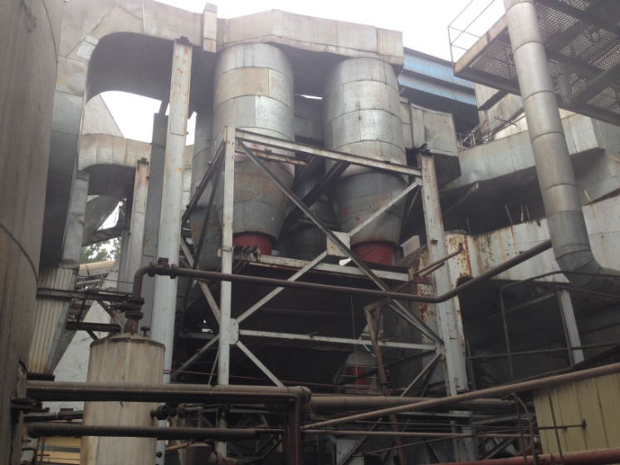
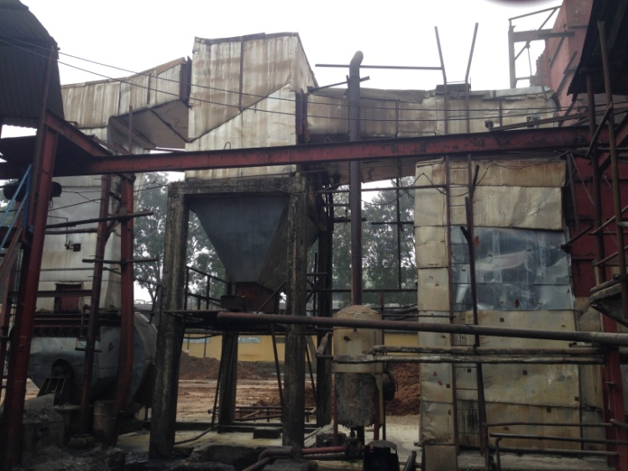
Reference- Dust collector
Quang Ngai Sugar factory
Equipment | Multi-Cyclone
Owner | Babcock Enterprise
Gas Volume(Am3/min) | 3,538
Start up Date | 1999
Application | Boiler (Coal + Sugar Cane)
Location: Quang Ngai, Vietnam

Slide 20
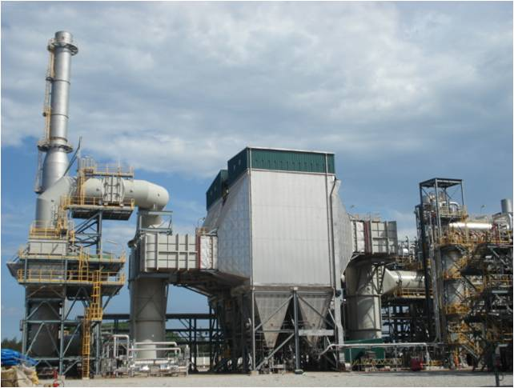
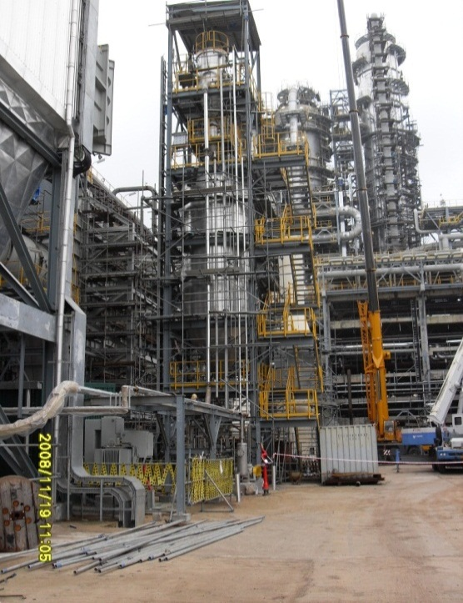

Reference - ESP and Ash Handling System
Dung Quat Oil Refinery
Owner | PVN, Vietnam
Client | JGC – Technip
Gas Volume (Nm3/hr) | 1,084,248
Start-up Date | 2009
Efficiency (%) | 99.91%
Location: Quang Ngai Province, Vietnam

Slide 21



Reference - ESP
Dong Nai VN2 Thermal Power Plant
Client | Formosa Plastic Group
Gas Volume(Nm3/hr) | 580,140
Inlet Dust(g/Nm3) | 19
Outlet Dust(mg/Nm3) | 22.9
Efficiency (%) | 99.88
Location: Nhon Trach 3 Industrial Zone, Dong Nai Province, Vietnam

Slide 22

Reference - ESP
Vissai Cement ( 6 units): Overhaul Kiln/Cooler ESP
ESP type | Kiln ESP/ Cooler : Ninh Binh Line 1&2, Ha nam Line 1&2, Song Lam, Anh Son
ESP’s Supplier | Henan Sinoma , Longcin, Wuhan Kaidi
Inlet concentration | ≤ 80 g/Nm3
Inlet temp | 100~120oC, max 300oC
Capacity | 480,000 m3/h
Gas speed | 0.78 m/min
TR specification | 1.6A/72KV
Other specification | 26~32GP/3F/14940mmCE
Kiln ESP

Slide 23






Reference - ESP
Vissai Cement ( 6 units): Overhaul Kiln/Cooler ESP

Slide 24



Reference – ESP (2 units)
Nghi Son 1 Thermal Power Plant
Owner | EVN
Client | Marubeni Corp.
Gas Volume(Nm3/min) | 1,574,379
Inlet Dust (g/Nm3) | 46.437
Outlet Dust(mg/Nm3) | 98.9
Efficiency (%) | 99.79
Location: Thanh Hoa Province, Vietnam

Slide 25



Reference - ESP and SCR (2 units x 600MW)
Mong Duong 2 Thermal Power Plant
Owner | AES+POSCO Power + CTCI(Taiwan)
EPC Contractor | Doosan Heavy Industry
Gas Volume (Am3/Hr) | 3,349,680
Inlet Dust (g/Nm3) | 55.5
Outlet Dust (mg/Nm3) | Less than 50
Efficiency (%) | 99. 91
Location: Mong Duong Town, Cam Pha Districts, Quang Ninh Province

Slide 26

Reference - ESP
Dong Nai VN3 Thermal Power Plant
Client | Formosa Plastic Group
EPC Contractor | KC Cottrell Vietnam
Gas Volume(Nm3/hr) | 580,140
Inlet Dust(g/Nm3) | 19
Outlet Dust(mg/Nm3) | 22.9
Efficiency (%) | 99.88
Location: Nhon Trach 3 Industrial Zone, Dong Nai Province, Vietnam

Slide 27







Slide 28




Reference – ESP - Maintenance
Dong Nai VN2 Thermal Power Plant
Client | Formosa Plastic Group
Gas Volume(Nm3/hr) | 580,140
Inlet Dust(g/Nm3) | 19
Outlet Dust(mg/Nm3) | 22.9
Efficiency (%) | 99.88
Location: Nhon Trach 3 Industrial Zone, Dong Nai Province, Vietnam

Slide 29


Reference – WET ESP (1 unit)
Ha Tinh Steel Mill Plant
Equipment | 1 of Wet-ESP (305,134 Nm3/hr) 6 of Fabric Filters (4 x 230,000 Am3/min)
Owner | FORMOSA H.I
Capacity | 15Million Ton/year
Location: Vung Ang, Ky Anh District, Ha Tinh province

Slide 30







Slide 31



Reference – AHS
Mong Duong 2 TPP(2x600MW):
Owner | AES+POSCO Power + CTCI(Taiwan)
EPC Contractor | Doosan Heavy Industry
Gas Volume (Am3/Hr) | 3,349,680
Inlet Dust (g/Nm3) | 55.5
Outlet Dust (mg/Nm3) | Less than 50
Efficiency (%) | 99. 91
Location: Mong Duong Town, Cam Pha Districts, Quang Ninh Province

Slide 32

Reference – 6 Bag Filter(1 unit)
Ha Tinh Steel Mill Plant
Equipment | 1 of Wet-ESP (305,134 Nm3/hr) 6 of Fabric Filters (4 x 23,000 Am3/min) 1x1000 Am3/min 1x1667 Am3/min
Owner | FORMOSA H.I
Capacity | 15Million Ton/year
Location: Vung Ang, Ky Anh District, Ha Tinh province

Slide 33







Slide 34









Slide 35




Reference – Long Phu #1
2x 600 MW
Equipment | WFGD & ESP
Client | Power Machine
Owner | PVN
Capacity | 2x 600 MW
Location: Chau Thanh , Hau Giang Province

Slide 36





Reference – Vinh Tan #4 Extension
1 x 600 MW
Equipment | Fly Ash Handling system
Client | PACIFIC CORP.
Owner | EVN
Capacity | 1x 600 MW
Location: Tuy Phong - BInh Thuan Province

Slide 37





Reference – Song Hau #1
2 x 600 MW
Equipment | Bottom Ash Handling system
Client | DHI
Owner | PVN
Capacity | 2x 600 MW
Location: Chau Thanh - Hau Giang Province

Slide 38





Reference – Duyen Hai #3 Extension
1x 660MW
Equipment | SWFGD
Client | Sumitomo/TSK
Owner | EVN Genco1
Capacity | 1x 660 MW
Location: Duyen Hai - Tra Vinh Province

Slide 39
Experience of spare part and technical service supply
No | Scope of supply | Application | Project | Completion year
1 | Support bushing | ESP | Nghi Son 1 TPP | 2013
3 | Thermometer | ESP | Nghi Son 1 TPP | 2013
4 | SRC Insulator assembly | ESP | Dung Quat Oil Refinery | 2013
5 | DE Shaft bearing | ESP | Dung Quat Oil Refinery | 2013
6 | DE tumble hammer | ESP | Dung Quat Oil Refinery | 2013
7 | DE driver chain 19 mm | ESP | Dung Quat Oil Refinery | 2013
8 | CE Hammer | ESP | Dung Quat Oil Refinery | 2013
9 | Driver shaft assemblies | ESP | Dung Quat Oil Refinery | 2013
10 | Jockey pulley shaft assemblies | ESP | Dung Quat Oil Refinery | 2013
14 | MCS II Controller system | Controller system | Dung Quat Oil Refinery | 2013
15 | Non-asbestos gasket | SCR | Mong Duong 2 TPP | 2013
16 | Stair way | ESP | Mong Duong 2 TPP | 2013
17 | MIGI Rapper Assemblies | ESP | Redball Technical Inc | 2013
18 | Porcelain Shaft | ESP | Redball Technical Inc | 2013
19 | Heater Blower thermostat control | ESP | Redball Technical Inc | 2013
20 | Maintenance Work | ESP | Dung Quat Oil Refinery | 2014
21 | Spare parts supply | ESP | Dung Quat Oil Refinery | 2014
22 | Bag filter supply | Bag filter | Dung Quat Oil Refinery | 2014
23 | Additional CE Bearing | ESP | Nghi Son 1 TPP | 2014
24 | NH3 painting work | NH3 tank | Mong Duong 2 TPP | 2014
25 | SCR Insulation installation | SCR | Mong Duong 2 TPP | 2014
26 | Repairing work | Expansion joint | Nghi Son 1 TPP | 2014
27 | Spare part supply | ESP | Dung Quat Oil Refinery | 2014
28 | Repairing work | FGD | Mong Duong 2 TPP | 2014
29 | Maintenance and technical service | ESP | VN2 TPP | 2014
30 | Remove rust and paint | Air Blow Heater | Mong Duong 2 TPP | 2014
31 | Repair MMI trouble | ESP | Nghi Son 1 TPP | 2014
32 | Erection supervision | Incinerator | Nga Bridge incinerator system | 2015
33 | Erection supervision | Incinerator | Nga Bridge incinerator system | 2015

Slide 40
Experience of spare part and technical service supply
No | Scope of supply | Application | Project | Completion year
34 | Level Sensor | ESP | Mong Duong 2 TPP | 2016
35 | Rapper Hammer | ESP | Mong Duong 2 TPP | 2016
36 | TR GDU control panel | ESP | Mong Duong 2 TPP | 2016
37 | CE, DE Shaft bearing | ESP | Nghi Son1 TPP | 2016
38 | DE tumble hammer | ESP | Dung Quat Oil Refinery | 2016
39 | MCS II Controller system | ESP | Dung Quat Oil Refinery | 2016
40 | Ball Rode & Insulator, gasket | ESP | Dung Quat Oil Refinery | 2016
41 | Driver motor | ESP | Dung Quat Oil Refinery | 2016
42 | Blower Impeller | ESP | Dung Quat Oil Refinery | 2016
43 | Technical Service | ESP | Dung Quat Oil Refinery | 2016
44 | Sonic hoist | SCR | Mong Duong 2 TPP | 2017
45 | DE FRP Shaft | ESP | Mong Duong 2 TPP | 2017
46 | MIGI Rapper Assemblies | ESP | Mong Duong 2 TPP | 2017
47 | Porcelain Shaft & Coupling | ESP | Mong Duong 2 TPP | 2017
48 | Hopper Heater | ESP | Mong Duong 2 TPP | 2017
49 | TR Fan | ESP | Mong Duong 2 TPP | 2017
50 | CE Bearing Sleeve | ESP | Mong Duong 2 TPP | 2017
51 | CE hammer Assembly | BASH | Mong Duong 2 TPP | 2017
52 | Oring, Piston | BASH | Mong Duong 2 TPP | 2017
53 | Cylinder, Air Blaster | BASH | Mong Duong 2 TPP | 2017
54 | TR Fan | ESP | VN2 TPP | 2018
55 | Blower & Motor, impeller | ESP | VN2 TPP | 2018
56 | Hammer Assembly | ESP | VN3 TPP | 2018
57 | Technical service supply | ESP | MD2 | 2019

Slide 41




Experience of Collecting Plate (CE) and Discharge Electrode (DE) Manufacture
KC Cottrell Vietnam has imported CE and DE Production Line and manufactured CE, DE ourselves to supply for projects in Vietnam.
Our products and production procedure have been supplied for 2 ESP Units of Nghi Son 1 project, VN3, VSHN1, Chanh Duong paper mill, and gained full satisfaction of customer and owner.
Manufacturing

Slide 42





5. SOCIAL ACTIVITIES
Scholarship ceremony for environmental emission treatment technology for Heat Engineering & Refrigeration(IHERE) of Hanoi University Technology
Sponsored for Hai Ha school, (Desks, Stools, Books and others) Address: Hai Ha Commune, Tinh Gia Dist., Thanh Hoa, VIETNAM 2012 (when we execute Nghi Son 1 Project)
Exhibition in Ho Chi Minh City - Power industry Viet Nam - 2012

Slide 43

Experience of KC Cottrell ( Holdings Company)
KC Cottrell Vietnam Co.,Ltd

